Slide 1

WAY TO ENTERPRISE
Java Basics
VTI ACADEMY
Author: duy.nguyenngoc1@vti.com.vn
March 2020

Slide 2
Agenda
Collection & Map
Comparing
Generic
Assignments
Copyright © VTI Academy All Rights Reserved

Slide 3
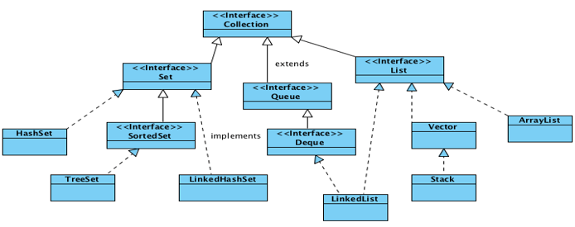
Collection
Array can manage object or primitive
Collection can only manage object
Polymorphism

Slide 4
List
Type
ArrayList
Stack

Slide 5
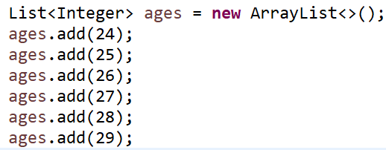
ArrayList
Init
Get Data

Slide 6
List’s Method
size()
get()
remove()
clear()

Slide 7
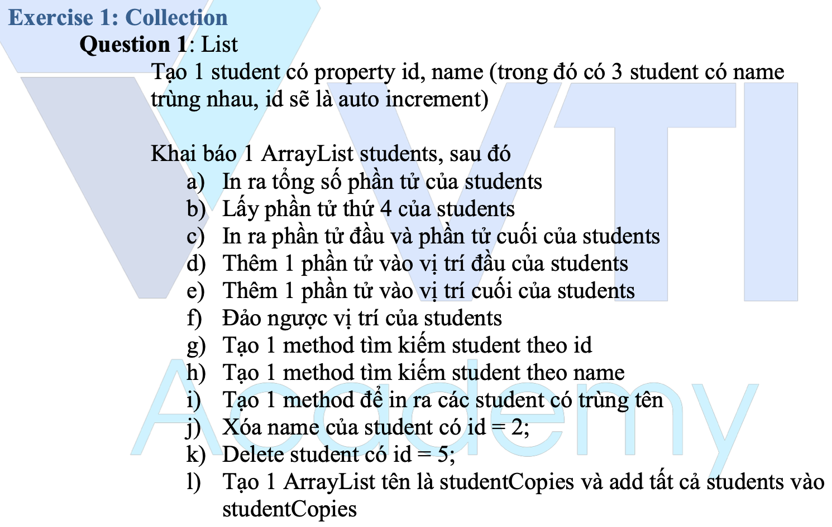
Testing System Assignments
Exercise 1: Collection - Question 1: List

Slide 8
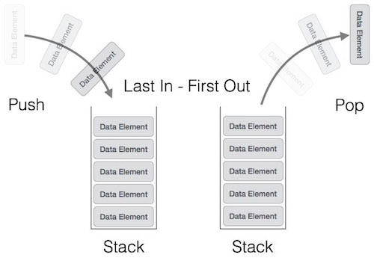
Stack
Methods
pop()
push()
peek()
isEmpty()

Slide 9
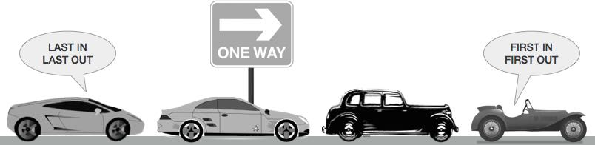
Queue
Methods
enqueue()
dequeue()
peek()
isFull()
isEmpty()

Slide 10
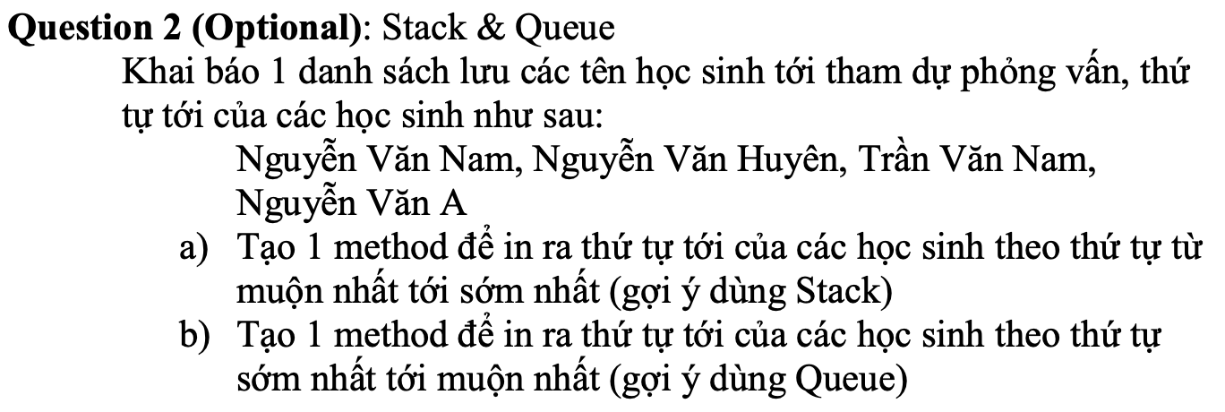
Testing System Assignments
Exercise 1: Collection - Question 2 (Optional): Stack & Queue

Slide 11
Accessing by Index & neighborhood
Accessing by Index (Ex: ArrayList)
Accessing by neighbourhood (HashSet, LinkedList)

Slide 12
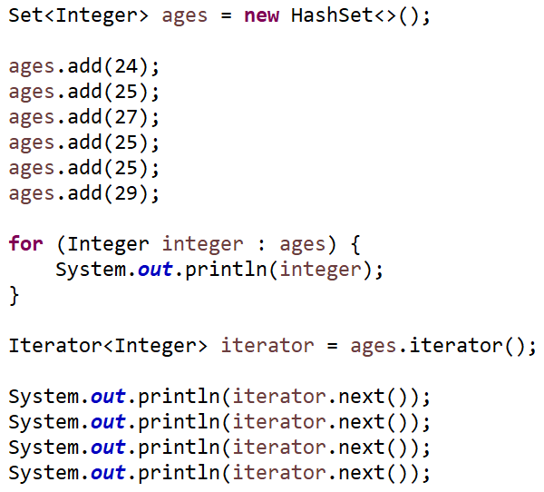
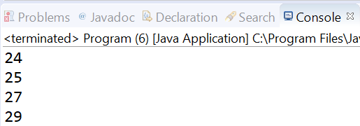
Set
Unique element

Slide 13
Testing System Assignments
Exercise 1: Collection - Question 3, 4, 5

Slide 14
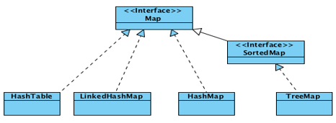
Map
Managing key-value

Slide 15
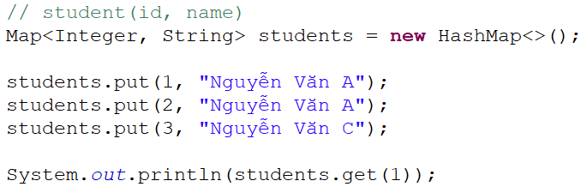
Example

Slide 16
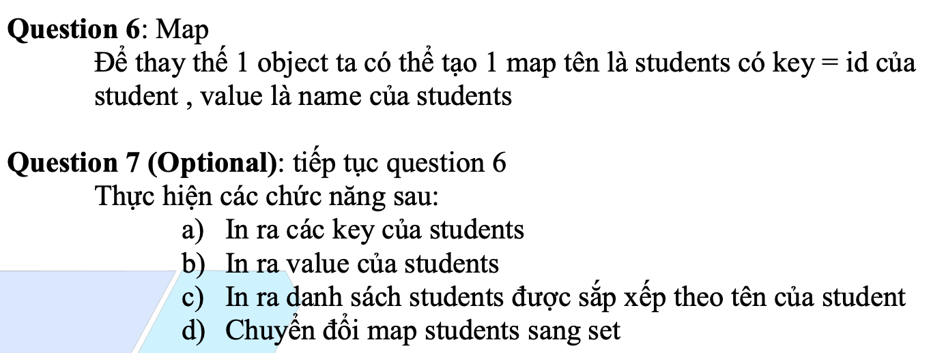
Testing System Assignments
Exercise 1: Collection - Question 6, 7

Slide 17
Comparing
Equals()
Hashcode()
Comparable (1 criteria)
Comparator (multiple criteria)

Slide 18
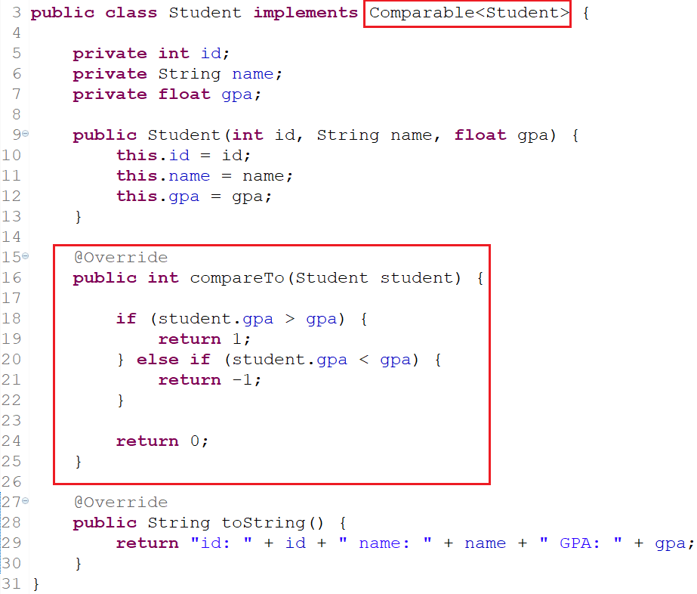
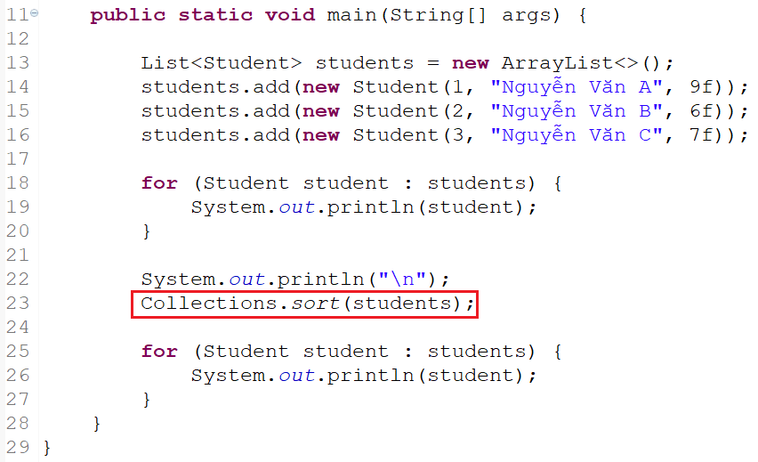
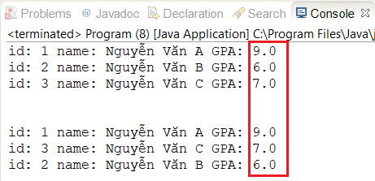
Comparable

Slide 19
Comparator
Self-study

Slide 20
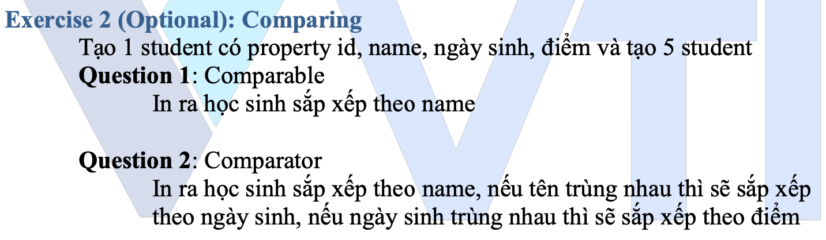
Testing System Assignments
Exercise 2 (Optional): Comparing

Slide 21
Generic
Common datatype as Object
Restrict
Cannot init object which has T datatype
Cannot using static
Type
Class
Method

Slide 22
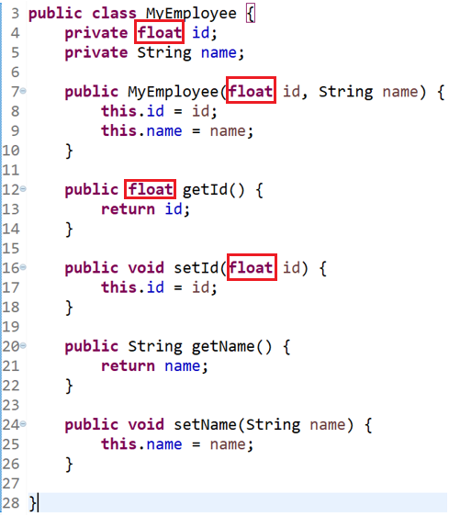
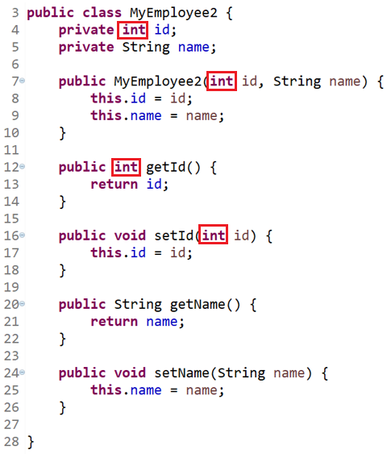
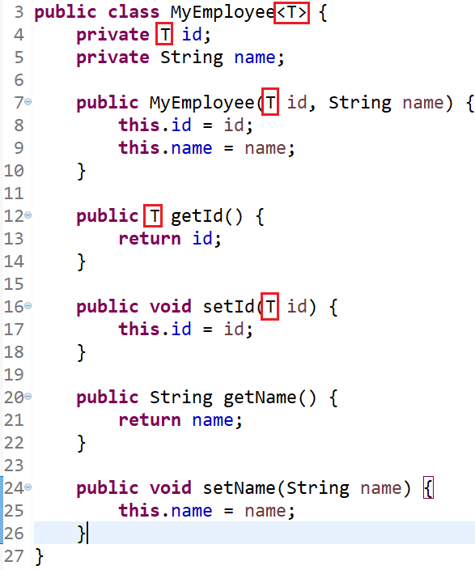
Generic For Class

Slide 23
Example
ArrayList, List

Slide 24
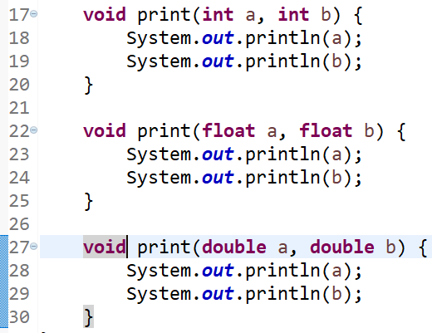
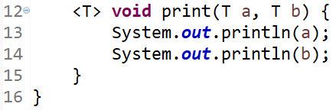
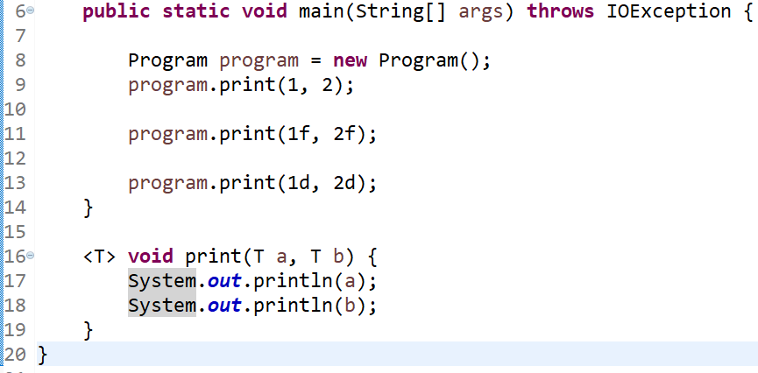
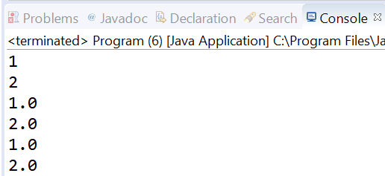
Generic for methods

Slide 25
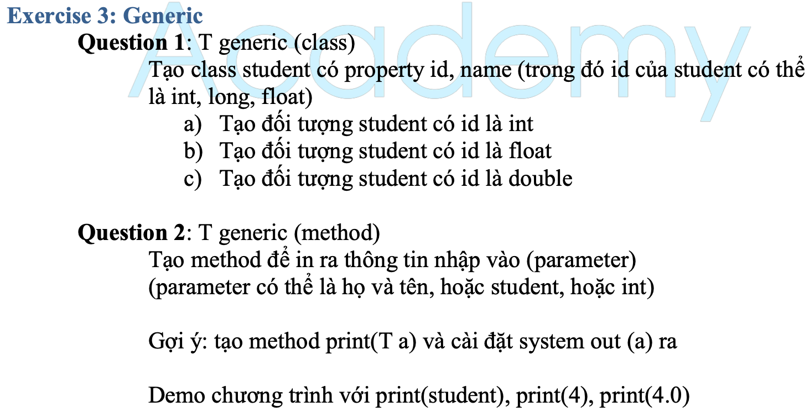
Testing System Assignments
Exercise 3: Generic - Question 1, 2

Slide 26
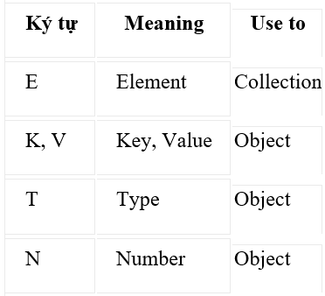
Generic

Slide 27
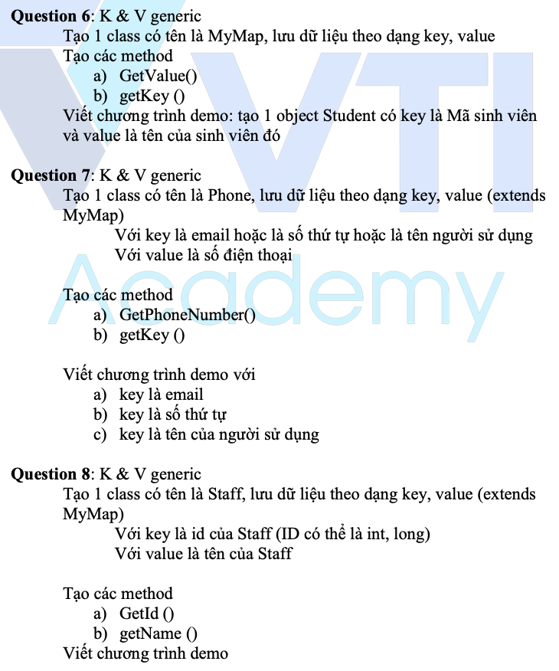
Testing System Assignments
Exercise 3: Generic - Question 4, 5, 6, 7, 8

Slide 28
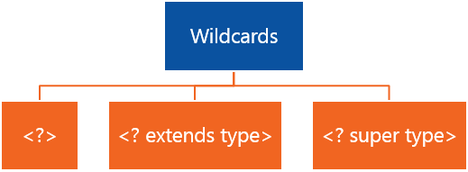
Wildcard

Slide 29
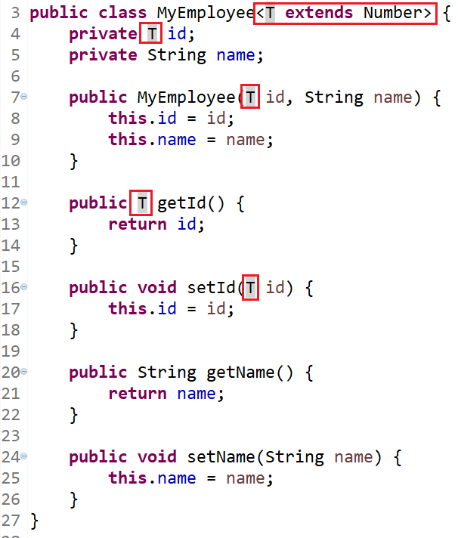
Example (class)

Slide 30
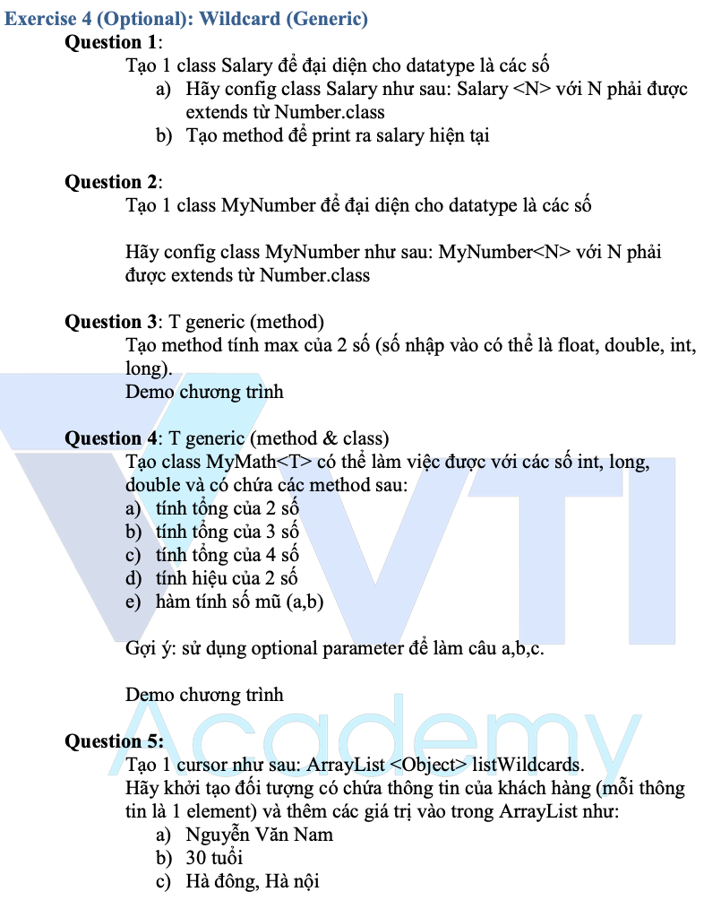
Testing System Assignments
Exercise 4 (Optional): Wildcard (Generic)

Slide 31
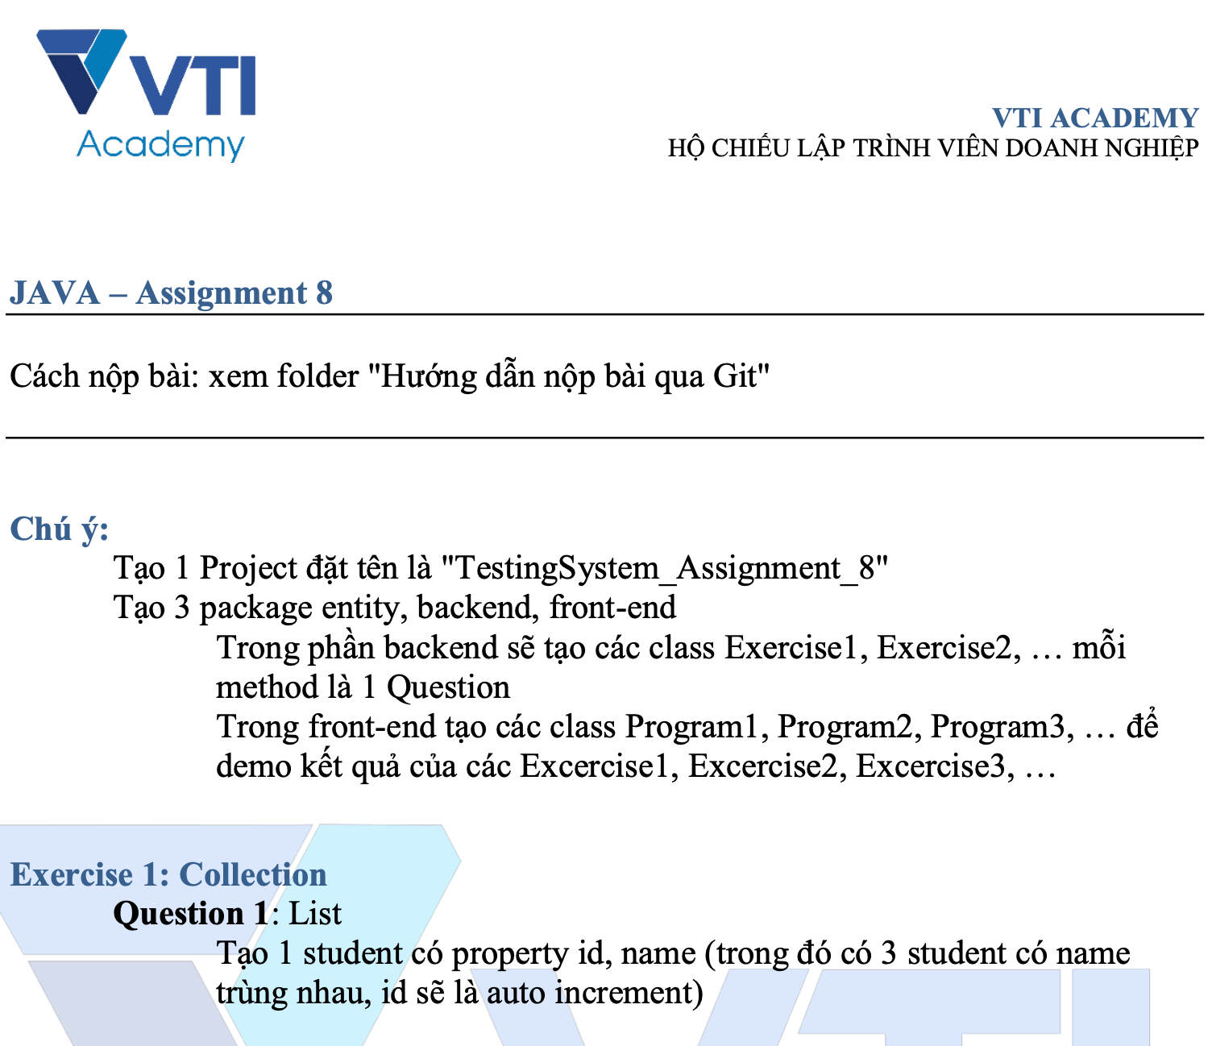
Testing System Assignments

Slide 32
Q & A
Copyright © VTI Academy All Rights Reserved

